Slide 1

OOP
Object Oriented Programming
Lecture 1
Lecture 1

Slide 2
Course Objective
Introduction to object oriented programming principles and techniques using C++

Slide 3
Learning Outcomes
Understand the benefits of object oriented programming
Design object oriented solutions for small systems involving multiple objects
Implement, test and debug solutions in C++

Slide 4
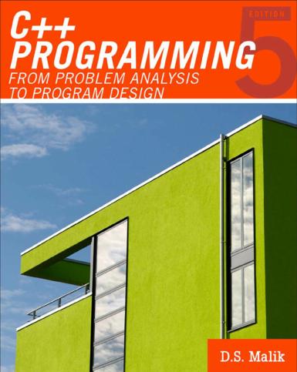
Text Book
C++ Programming: Program Design including Data Structures. 5th Edition. D.S. Malik.
Soft copy on Google Classroom

Slide 5
Books
C++ PROGRAMMING: Program Design Including Data Structures Fifth Edition by D.S. MALIK
“C++ How to Program” , 7th edition, Deitel & Deitel
“Herbert Schildt, “C/C++, The Complete Reference”, 3rd Edition Osborne McGraw-Hill, ISBN 0-07-882476-1”
“Bruce Eckel, “Thinking in C++”, 2nd Ed, Pearson Publication, ISBN 81-7808-297-7”
“Bjarne Stroustrup, “The C++ Programming Language” 3rd Ed, Addison Wesley, ISBN 0-201-88954-4 0”
Robert Lafore, “Object Oriented Programming using C++”, 3rd Ed, SAMS, December 1998
Compiler: VS code / Dev-C / Any other that supports C++ language

Slide 6
Introduction

Slide 7
Programming methodologies

Slide 8
Programming Paradigms
1- Sequential
2- Procedural
3- Object Oriented

Slide 9
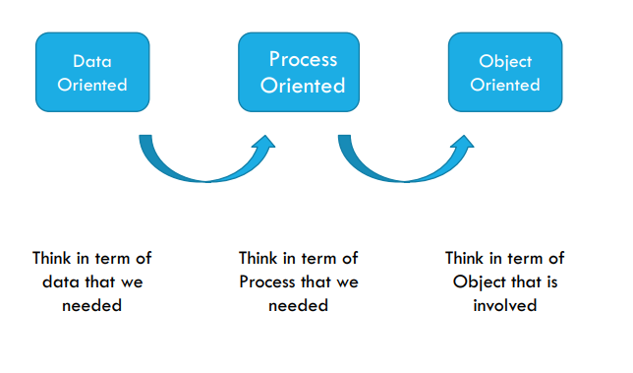
Programming Paradigms

Slide 10
Structured vs. Object Oriented
Dividing a problem into smaller sub-problems
Analyze and devise solution to each sub-problem
Combine solutions to solve overall problem
Identify components, known as objects which will form the basis of the solution
Determine how the objects interact with each other

Slide 11
Structured vs. Object Oriented
Suited when for example manipulation of numbers is required with mathematical functions
Automation for vending machine
A game where players interact with elements in the environment
Basically any problem that can be defined in terms of objects

Slide 12
struct
Recap

Slide 13
Object Oriented Programming
Definition: Object-oriented programming focuses on identifying entities in the problem space (called
In C++, a structure (often abbreviated as struct) is a user-defined data type that allows grouping of different data types together. It is similar to a class but with a key difference: by default, all members of a struct are public, whereas in a class they are private.
Defining a Structure
A structure is defined using the struct keyword, followed by the structure name and the member variables.

Slide 14
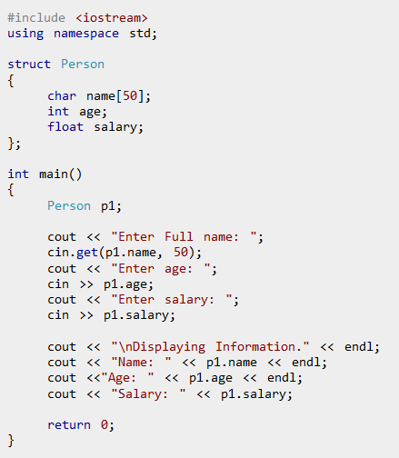
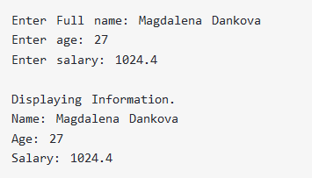
struct
Recap

Slide 15
Designing and Using Objects
Represent data in computer memory
Manipulate data
Implement operations
Algorithm implementation using functions
Control structures
Arrays
…
All of these concepts have been covered in the previous programming course.

Slide 16
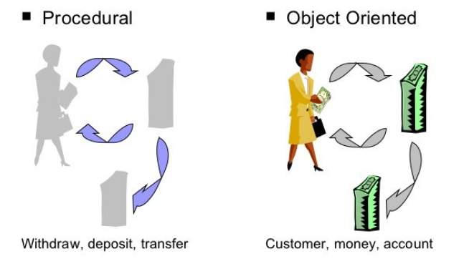
Procedural vs. Object-Oriented Programming

Slide 17
Procedural vs. Object-Oriented Programming
The unit in procedural programming is function, and unit in object-oriented programming is class
Procedural programming concentrates on creating functions, while object-oriented programming starts from isolating the classes, and then look for the methods inside them.

Slide 18
Terminology
Object oriented design (OOD)
Object oriented programming (OOP)
Object oriented programming language

Slide 19
What is a Model?
A model is an abstraction of something
Real World Entities
Purpose is to understand the product before developing it

Slide 20
Examples – Model
Highway maps
Architectural models
Mechanical models
Notes:
End of lecture 1

Slide 21
End of Lecture

